Slide 1

APBD – lecture 11/12
WebAssembly
Blazor – client side

Slide 2
WebAssembly
WebAssembly is a new type of code that can be run in modern web browsers — it is a low-level assembly-like language with a compact binary format that runs with near-native performance and provides languages such as C/C++, C# and Rust with a compilation target so that they can run on the web. It is also designed to run alongside JavaScript, allowing both to work together.

Slide 3
SPA
A single-page application (SPA) is a web application or website that interacts with the user by dynamically rewriting the current web page with new data from the web server, instead of the default method of a web browser loading entire new pages.

Slide 4
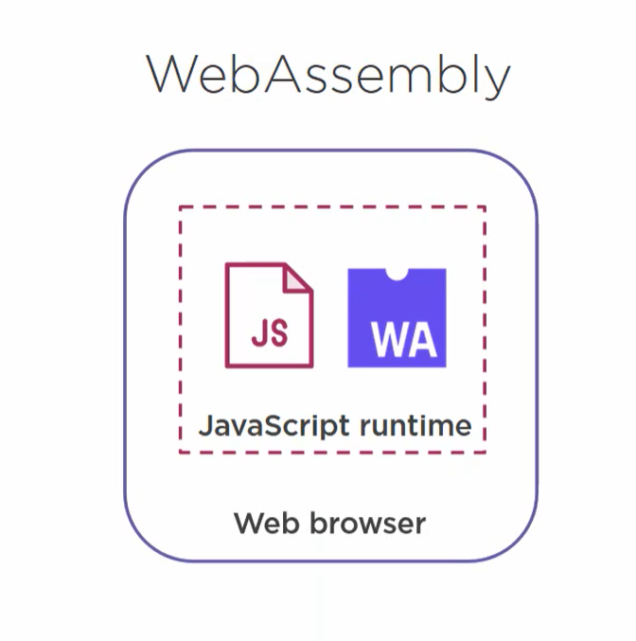
WebAssembly

Slide 5
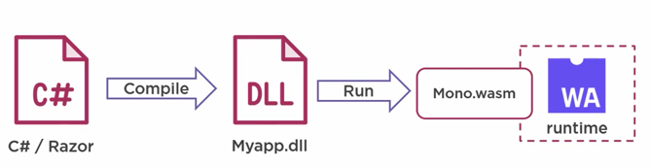
WebAssembly – C#

Slide 6
Introduction to ASP.NET Core Blazor
Blazor is a framework for building interactive client-side web UI with .NET:
Create rich interactive UIs using C# instead of JavaScript.
Share server-side and client-side app logic written in .NET.
Render the UI as HTML and CSS for wide browser support, including mobile browsers.
Integrate with modern hosting platforms, such as Docker.

Slide 7
Blazor Client Side - advantages
Using .NET for client-side web development offers the following advantages:
Write code in C# instead of JavaScript.
Leverage the existing .NET ecosystem of .NET libraries.
Share app logic across server and client.
Benefit from .NET's performance, reliability, and security.
Stay productive with Visual Studio on Windows, Linux, and macOS.
Build on a common set of languages, frameworks, and tools that are stable, feature-rich, and easy to use.

Slide 8
Blazor Client Side - features
Blazor Client Side is using the same features we have discussed during our last lecture:
Component based architecture
@page directive and routing mechanism

Slide 9
Blazor Client Side – hosting model
The primary Blazor hosting model is running client-side in the browser on WebAssembly. The Blazor app, its dependencies, and the .NET runtime are downloaded to the browser.
The app is executed directly on the browser UI thread.
UI updates and event handling occur within the same process. The app's assets are deployed as static files to a web server or service capable of serving static content to clients.

Slide 10
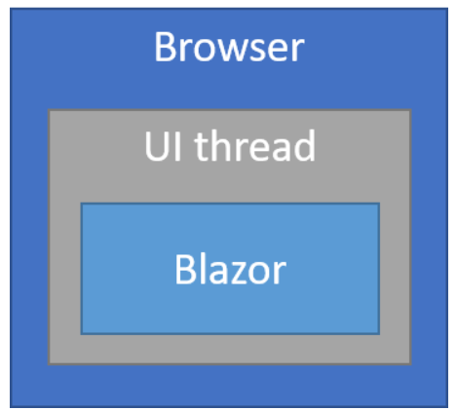
Blazor Client Side – hosting model

Slide 11
Blazor Client Side – hosting model
When the Blazor WebAssembly app is created for deployment without a backend ASP.NET Core app to serve its files, the app is called a standalone Blazor WebAssembly app.
When the app is created for deployment with a backend app to serve its files, the app is called a hosted Blazor WebAssembly app.

Slide 12
Blazor Client Side – hosting model
A hosted Blazor WebAssembly Client app typically interacts with the backend Server app over the network using web API calls or SignalR (Use ASP.NET Core SignalR with Blazor).

Slide 13
Example – initial project structure

Slide 14
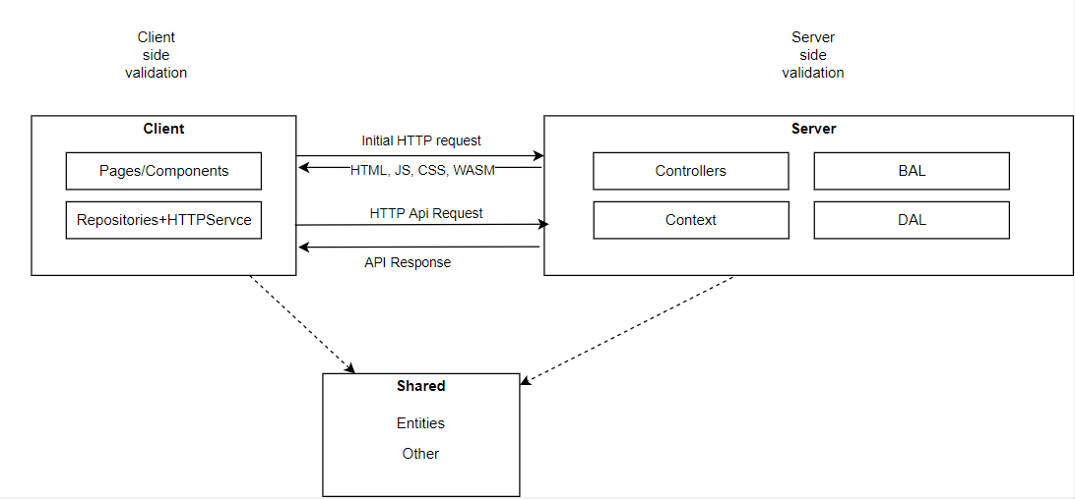
Communication between backend and frontend

Slide 15
Blazor Client Side – project structure
The blazor.webassembly.js script is provided by the framework and handles:
Downloading the .NET runtime, the app, and the app's dependencies.
Initialization of the runtime to run the app.

Slide 16
PWA – Progressive Web Apps
The term "Progressive Web App" isn't a formal or official name. It's just a shorthand used initially by Google for the concept of creating a flexible, adaptable app using only web technologies.

Slide 17
PWA – Progressive Web Apps
Progressive Web Apps (PWAs) provide access to open web technologies for cross-platform interoperability and provide your users with a native, app-like experience customized for their devices.
PWAs are websites that are progressively enhanced to function like native apps on supporting platforms. The qualities of a PWA combine the best of the web and native apps.

Slide 18
What makes an app a PWA?
PWAs are not created with a single technology
They represent a new philosophy for building web apps, involving some specific patterns, APIs, and other features.
. It's not that obvious if a web app is a PWA or not from first glance.
An app could be considered a PWA when it meets certain requirements, or implements a set of given features: works offline, is installable, is easy to synchronize, can send push notifications, etc.

Slide 19
What makes an app a PWA?
In addition, there are tools to measure how complete (as a percentage) a web app is, such as Lighthouse.
By implementing various technological advantages, we can make an app more progressive, thus ending up with a higher Lighthouse score. But this is only a rough indicator.

Slide 20
PWA characteristics
Discoverable:
the contents can be found through search engines.
Installable
it can be available on the device's home screen or app launcher.
Linkable
so you can share it by sending a URL
Network independent
so it works offline or with a poor network connection.

Slide 21
PWA characteristics
Progressive
so it's still usable on a basic level on older browsers, but fully-functional on the latest ones.
Re-engageable
so it's able to send notifications whenever there's new content available
Responsive
so it's usable on any device with a screen and a browser—mobile phones, tablets, laptops, TVs, refrigerators, etc.
Safe
so the connections between the user, the app, and your server are secured against any third parties trying to get access to sensitive data.

Slide 22
Blazor Client Side – advantages
The Blazor WebAssembly hosting model offers several benefits:
There's no .NET server-side dependency. The app is fully functioning after it's downloaded to the client.
Client resources and capabilities are fully leveraged.
Work is offloaded from the server to the client.
An ASP.NET Core web server isn't required to host the app. Serverless deployment scenarios are possible, such as serving the app from a Content Delivery Network (CDN).

Slide 23
Blazor Client Side – disadvantages
The app is restricted to the capabilities of the browser.
Capable client hardware and software (for example, WebAssembly support) is required.
Download size is larger, and apps take longer to load.
.NET runtime and tooling support is less mature. For example, limitations exist in .NET Standard support and debugging.

Slide 24
Blazor Client Side – server-hosted
Usually SPA require some kind of remote API to communicate with database and/or other services

Slide 25
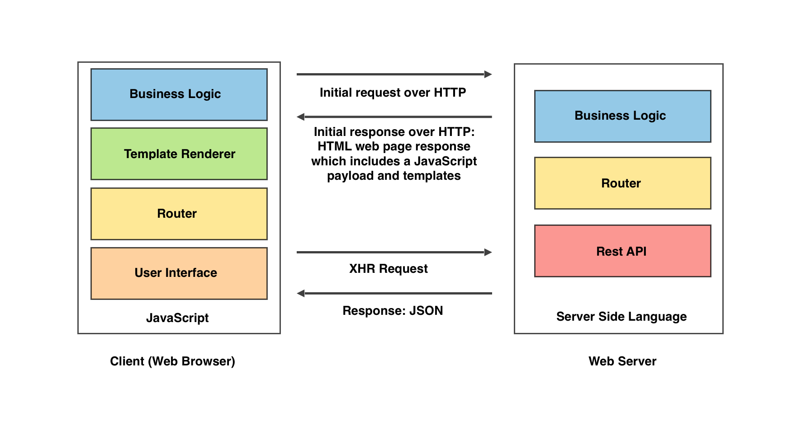
Blazor Client Side – server-hosted

Slide 26
Isomorphic web application architecture
The isomorphic web application architecture consists of implementing two web applications, one on the server side and one on the client side, using the same programming language and reusing code across the two environments.

Slide 27
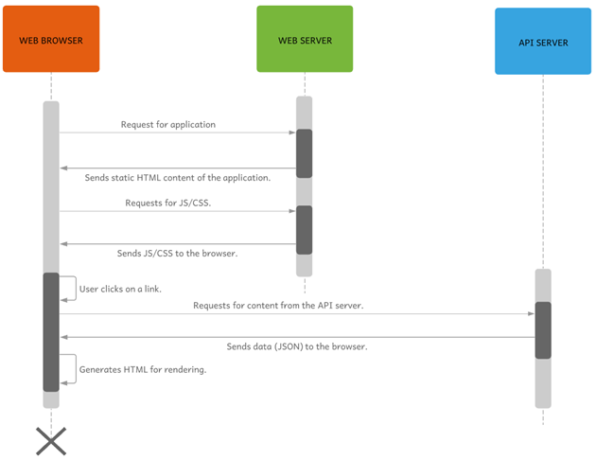
Blazor Client Side – server-hosted

Slide 28
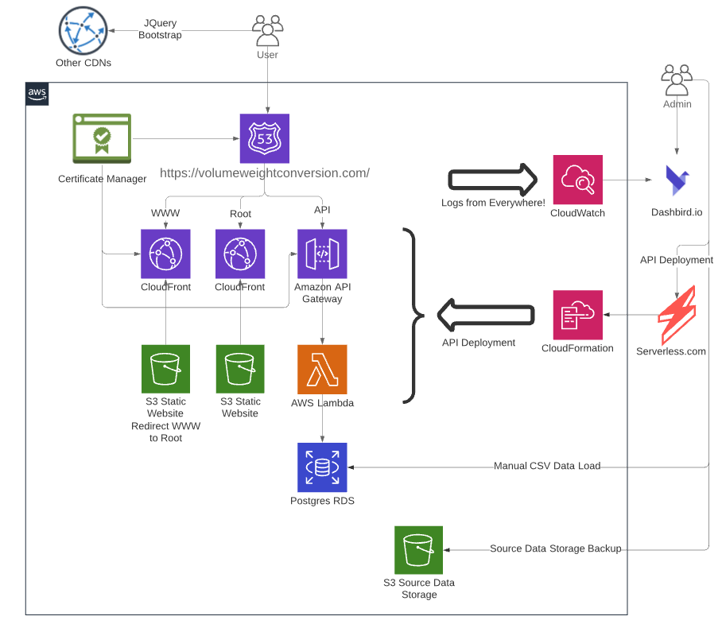
Blazor Client Side – server-hosted

Slide 29
Question – why do we need backend?

Slide 30
Blazor Client Side app
Project structure
Fundamentals
Dependency injection
Static files
Configuration
Layouts
Components
Routing
Forms
API communication
Security

Slide 31
ASP.NET Core Blazor forms and validation
The Blazor framework supports webforms with validation using the EditForm component bound to a model that uses data annotations.

Slide 32
ASP.NET Core Blazor forms and validation
An EditForm creates an EditContext based on the assigned model instance as a cascading value for other components in the form.
The EditContext tracks metadata about the edit process, including which fields have been modified and the current validation messages.
Assigning to either an EditForm.Model or an EditForm.EditContext can bind a form to data.

Slide 33
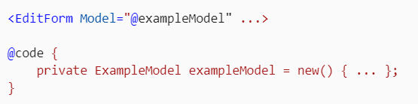
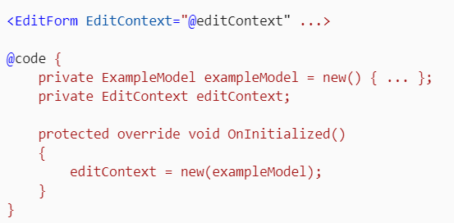
ASP.NET Core Blazor forms and validation

Slide 34
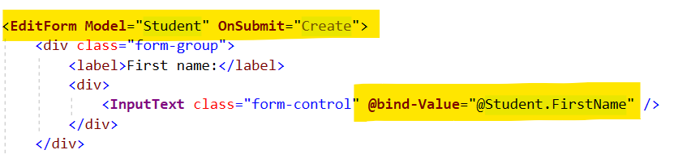
ASP.NET Core Blazor forms and validation

Slide 35
ASP.NET Core Blazor forms and validation form submission
The EditForm provides the following callbacks for handling form submission:
Use OnValidSubmit to assign an event handler to run when a form with valid fields is submitted.
Use OnInvalidSubmit to assign an event handler to run when a form with invalid fields is submitted.
Use OnSubmit to assign an event handler to run regardless of the form fields' validation status. The form is validated by calling EditContext.Validate in the event handler method. If Validate returns true, the form is valid.

Slide 36
Built-in form components
The Blazor framework provides built-in form components to receive and validate user input.
Inputs are validated when they're changed and when a form is submitted. Available input components are shown in the following table.

Slide 37
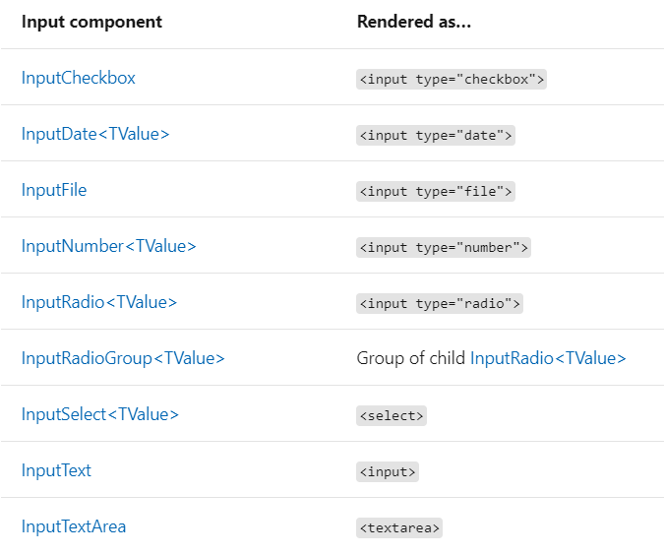
Built-in form components

Slide 38
Built-in form components
All of the input components, including EditForm, support arbitrary attributes.
Any attribute that doesn't match a component parameter is added to the rendered HTML element.

Slide 39
Built-in form components
Input components provide default behavior for validating when a field is changed, including updating the field CSS class to reflect the field's state as valid or invalid.
Some components include useful parsing logic.
For example, InputDate<TValue> and InputNumber<TValue> handle unparseable values gracefully by registering unparseable values as validation errors.

Slide 40
Built-in form components
Display name support:
The following built-in components support display names with the InputBase<TValue>.DisplayName parameter:
InputDate<TValue>
InputNumber<TValue>
InputSelect<TValue>

Slide 41
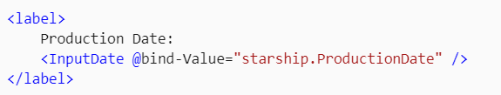

Built-in form components
If the field contains an invalid date when the form is submitted, the error message doesn't display a friendly name. The field name, "ProductionDate" doesn't have a space between "Production" and "Date" when it appears in the validation summary:

Slide 42
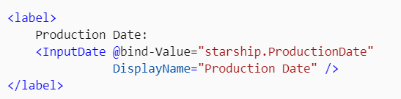

Built-in form components
The validation summary displays the friendly name when the field's value is invalid:

Slide 43
Example

Slide 44
Data Annotations Validator component and custom validation
The DataAnnotationsValidator component attaches data annotations validation to a cascaded EditContext.
Enabling data annotations validation requires the DataAnnotationsValidator component.
To use a different validation system than data annotations, use a custom implementation instead of the DataAnnotationsValidator component.

Slide 45
Data Annotations Validator component and custom validation
Blazor performs two types of validation:
Field validation is performed when the user tabs out of a field. During field validation, the DataAnnotationsValidator component associates all reported validation results with the field.
Model validation is performed when the user submits the form. During model validation, the DataAnnotationsValidator component attempts to determine the field based on the member's name that the validation result reports.
Validation results that aren't associated with an individual member are associated with the model rather than a field.

Slide 46
Validator components
Validator components support form validation by managing a ValidationMessageStore for a form's EditContext.
The Blazor framework provides the DataAnnotationsValidator component to attach validation support to forms based on validation attributes (data annotations).
You can create custom validator components to process validation messages for different forms on the same page or the same form at different steps of form processing.

Slide 47
Validator components – step-by-step
Create a validator component from ComponentBase:
When the validator component is initialized, a new ValidationMessageStore is created to maintain a current list of form errors.
The message store receives errors when developer code in the form's component calls the DisplayErrors method. The errors are passed to the DisplayErrors method in a Dictionary<string, List<string>>. In the dictionary, the key is the name of the form field that has one or more errors. The value is the error list.

Slide 48
Validator components – step-by-step
Messages are cleared when any of the following have occurred:
Validation is requested on the EditContext when the OnValidationRequested event is raised. All of the errors are cleared.
A field changes in the form when the OnFieldChanged event is raised. Only the errors for the field are cleared.
The ClearErrors method is called by developer code. All of the errors are cleared.

Slide 49
Validation on client and backend side
Server validation is supported in addition to client-side validation:
Process client-side validation in the form with the DataAnnotationsValidator component.
When the form passes client-side validation (OnValidSubmit is called), send the EditContext.Model to a backend server API for form processing.
Process model validation on the server.
The server API includes both the built-in framework data annotations validation and custom validation logic supplied by the developer. If validation passes on the server, process the form and send back a success status code (200 - OK). If validation fails, return a failure status code (400 - Bad Request) and the field validation errors.
Either disable the form on success or display the errors.

Slide 50
Differences between client-side and server-side validation

Slide 51
Communication between backend and frontend
Putting everything together
More complex componenets
Generic list
Paging
HTTP communication
Smart vs Dumb Componenents

Slide 52
Communication between backend and frontend
Client side
Business logic (thin or fat client)
Validation (UX)
Server side
Business logic
Validation
Communication with database
Shared
Entities shared between server and client-side code

Slide 53
Bibliography
+ https://docs.microsoft.com/en-us/aspnet/core/blazor/?view=aspnetcore-5.0
https://subscription.packtpub.com/book/web_development/9781788394185/1/ch01lvl1sec12/the-single-page-application-spa-architecture
https://docs.microsoft.com/en-us/aspnet/core/blazor/progressive-web-app?view=aspnetcore-5.0&tabs=visual-studio
https://developer.mozilla.org/en-US/docs/Web/Progressive_web_apps/Introduction

